Slide 1

Session Advance Excel
Presenter name
Abhishek Anand

Slide 2

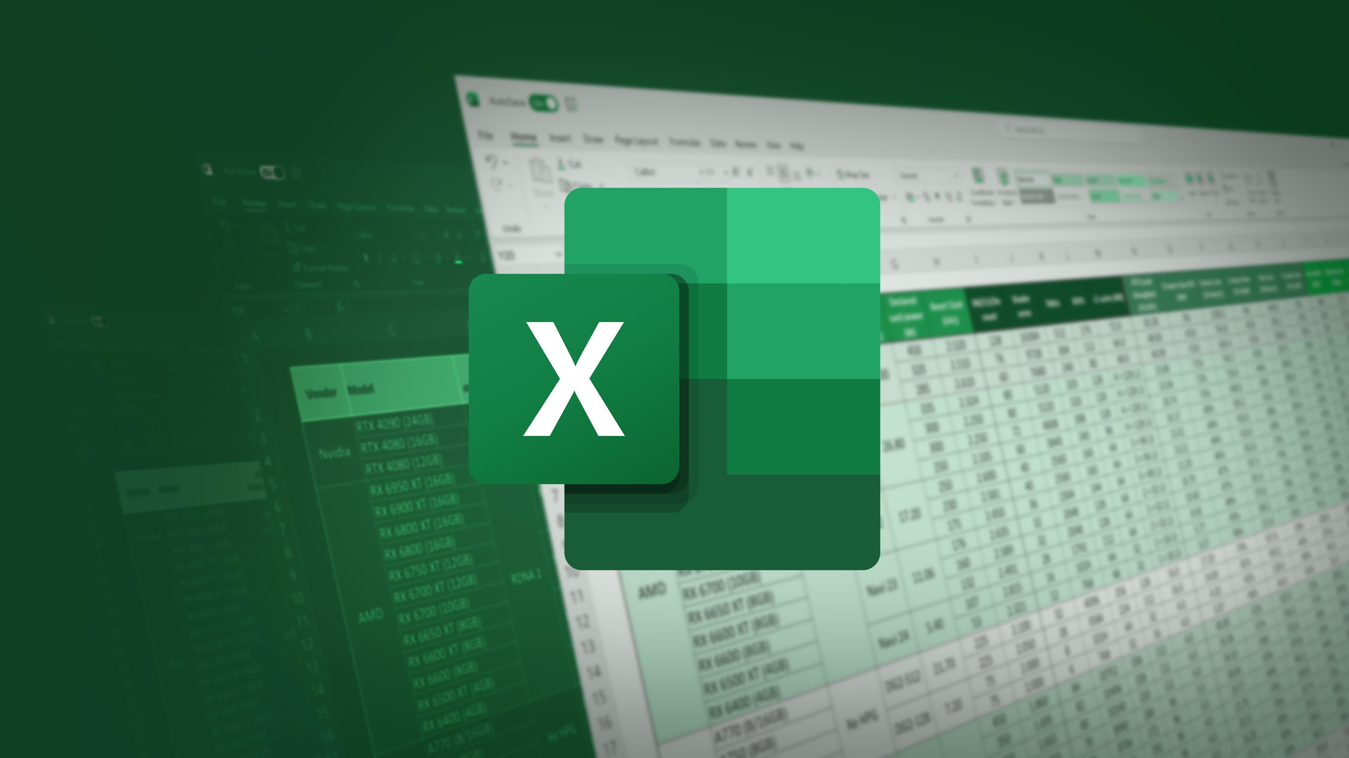
Agenda
VLOOKUP, HLOOKUP
Pivot Table
Slicers

Slide 3
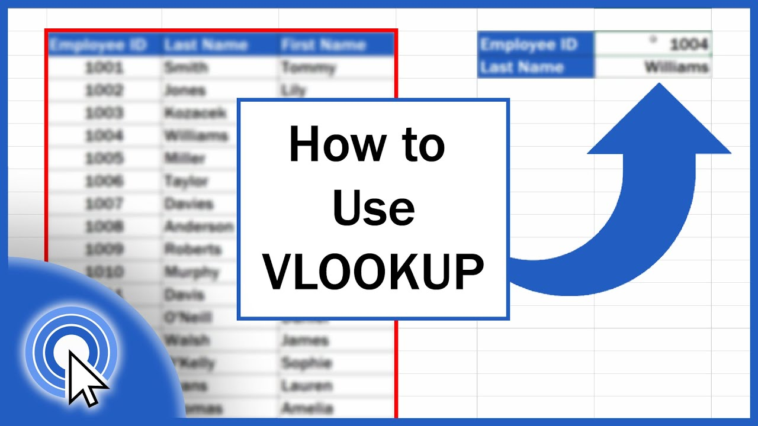
VLOOKUP
Syntax : =VLOOKUP(What you want to look up, where you want to look for it, the column number in the range containing the value to return, return an Approximate or Exact match – indicated as 1/TRUE, or 0/FALSE).S

Slide 4

Pivot Table
Pivot tables can help you summarize and make sense of large data sets. However, they also have a reputation for being complicated.
Pivot tables are particularly useful if you have long rows or columns that hold values you need to track the sums of and easily compare to one another.

Slide 5
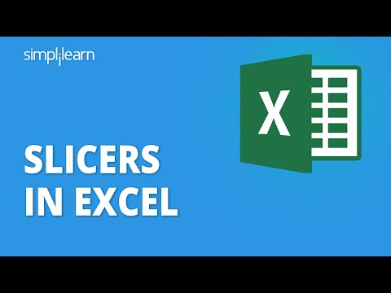
Slicers
Slicers in Excel are implemented along with the Excel tables and pivot tables to act as one-click software
Filters to filter out the required information from an enormous collection of data within a fraction of seconds.

Slide 6

Thank you

